Slide 1
Timberton Village Homeowners Association Annual Membership Meeting June 24, 2019

Slide 2
Topics
TVHA Status
Achievements this past year
Future Focus
Voting Options

Slide 3
TVHA Status 2019
Successfully Changed Board Meeting schedule to quarterly
Replaced Monument signage
Good fiscal management kept dues at current level for the second year in a row
The Website continues to be dynamic, current and informative thanks to Webmaster Rick Hellewell

Slide 4
History: End-of-Year Fund Balances
Fiscal Year | Type | Reserve | Uncommitted | Total
2011-12 | Actual | $23,416 | $32,789 | $56,205
2012-13 | Actual | $15,699 | $18,921 | $34,620
2013-14 | Actual | $18,180 | $16,810 | $34,990
2014-15 | Actual | $21,597 | $22,054 | $43,652
2015-16 | Actual | $32,247 | $20,259 | $52,505
2016-17 | Actual | $36,213 | $23,763 | $59,976
2017-18 | Actual | $40,541 | $26,078 | $66,619
2018-19 | Projected | $43,404 | $18,822 | $62,226

Slide 5
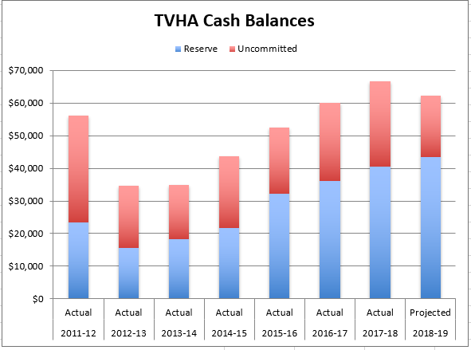
History: End-of-Year Fund Balances

Slide 6
2018-19 Projected Year-end Cash Balance
 | Projected Cash Balances Detailed by Account:
 |  | CD # 234 - reserve asset replacement |  |  | 35,773
 |  | CD # 235 - temporary reserve asset replacement |  |  | 2,316
 |  | CD # 233 - reserve for uncertainties |  |  | 5,315
 |  | CD # 231 - unallocated funds |  |  | 9,035
 |  | Checking |  |  | 9,786
 |  | Total |  |  | 62,226
 | Projected Cash Balance Detailed by Category:
 |  | Reserve Accounts - Asset Replacement & Uncertainties |  |  | 43,404
 |  | Uncommitted Balance |  |  | 18,822
 |  | Total |  |  | 62,226

Slide 7
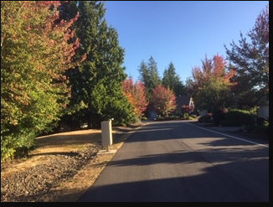
Timberton in fall

Slide 8
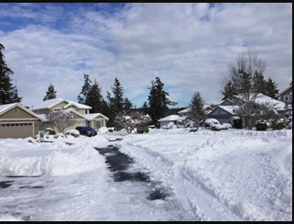
Timberton in winter

Slide 9
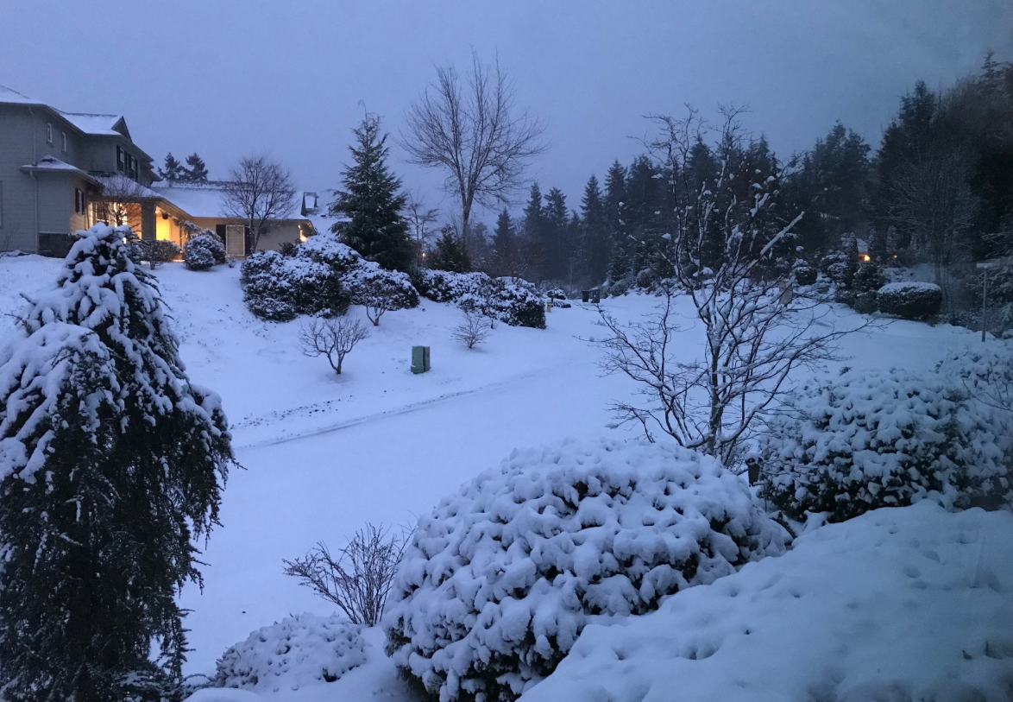
Timberton in winter

Slide 10
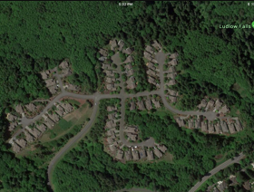
Timberton from outer space

Slide 11
Grounds Maintenance Contract
Contract awarded to Greenstate in 2018
2 year Contract
Overall Board is satisfied with performance
The next contract (2020-2022) might call for increasing frequency of mowing the entrance roadway from very 2 weeks to weekly during the high growth weeks

Slide 12
Vegetation Management Projects
Many snow damaged trees removed
Planted entrance at bottom of Timberton drive

Slide 13
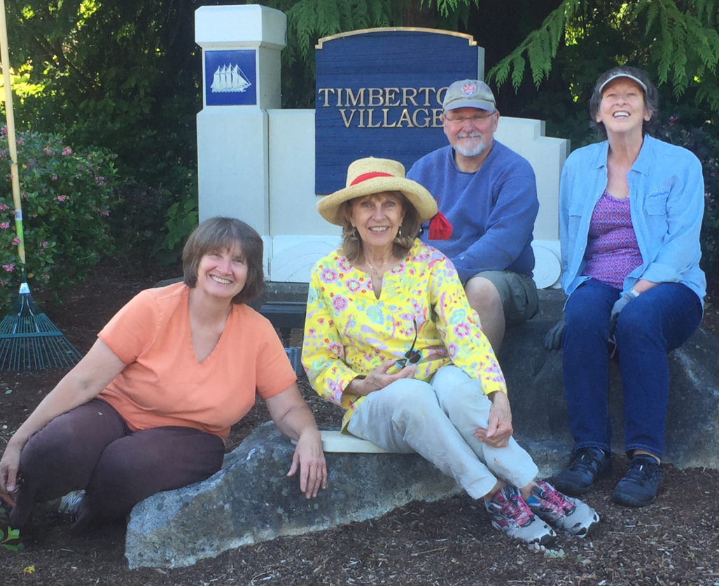
Many thanks to your neighbors at work

Slide 14
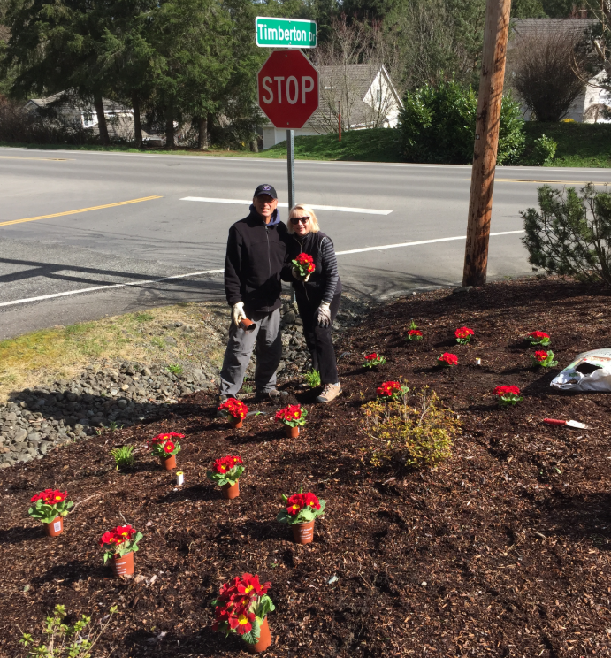
Many thanks to your neighbors at work

Slide 15
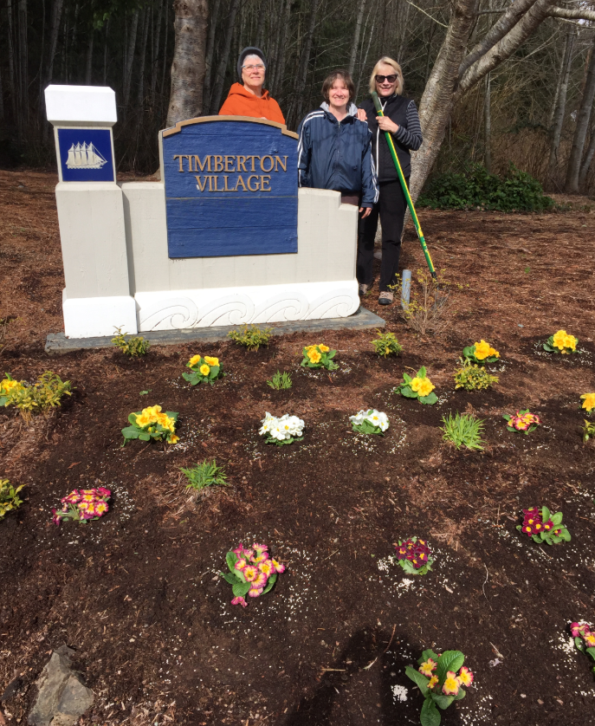
Many thanks to your neighbors at work

Slide 16
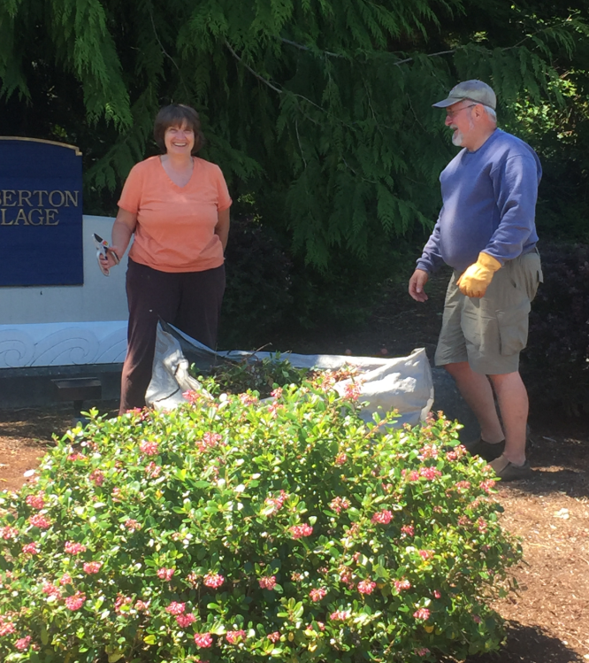
Many thanks to your neighbors at work

Slide 17
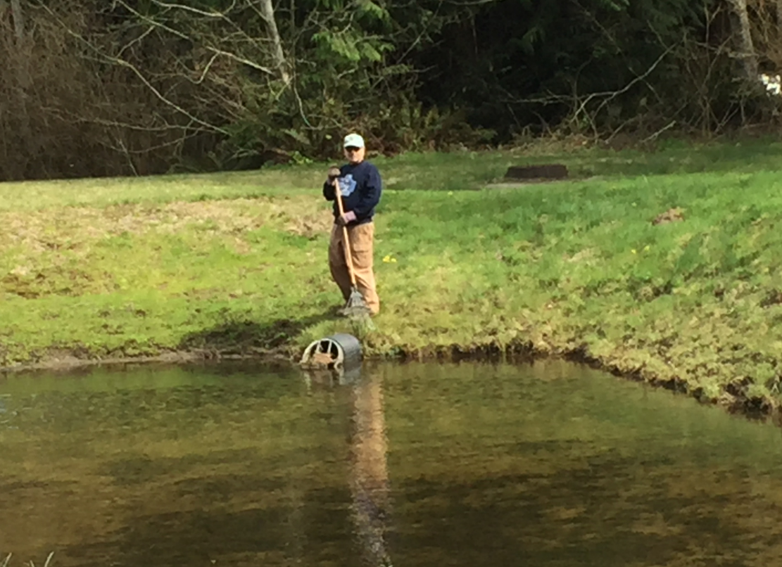
Many thanks to your neighbors at work

Slide 18
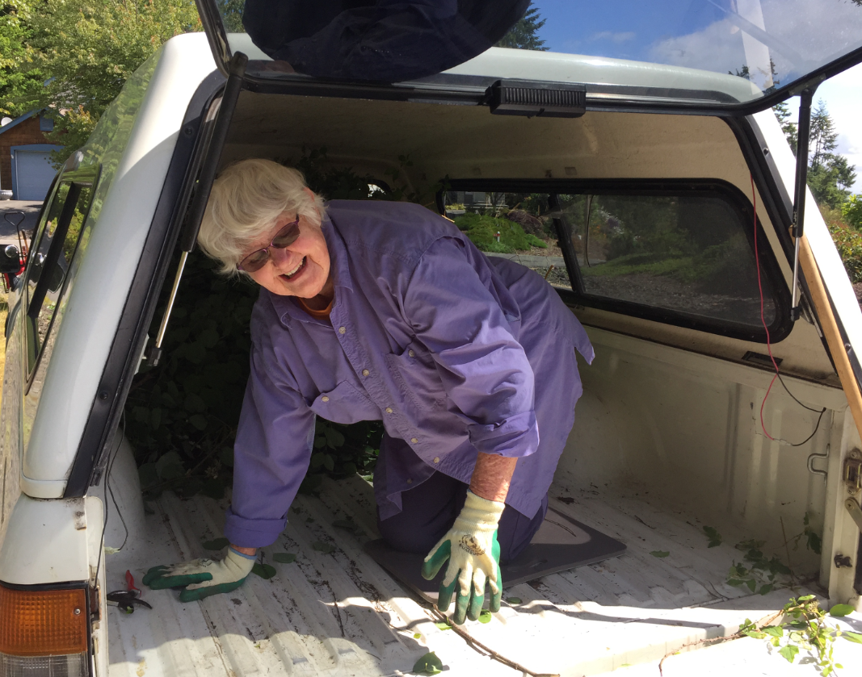
Many thanks to your neighbors at work

Slide 19
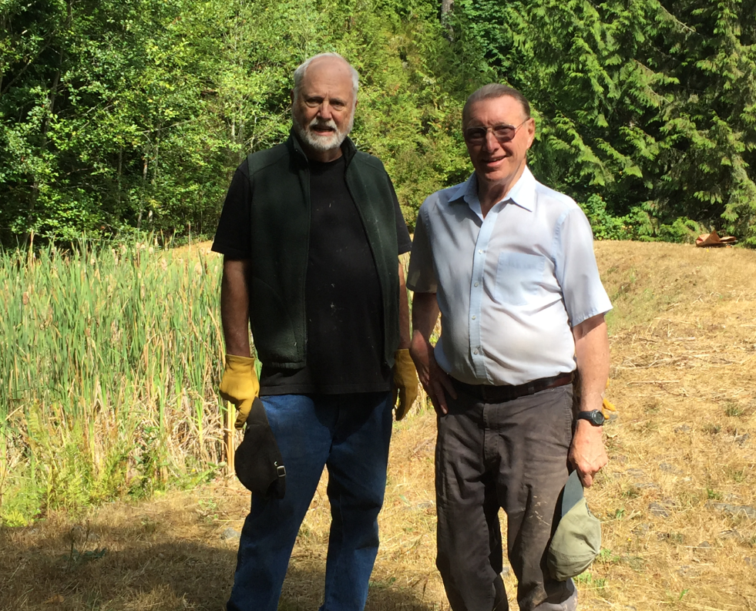
Many thanks to your neighbors at work

Slide 20
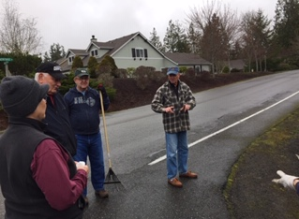
Many thanks to your neighbors at work

Slide 21
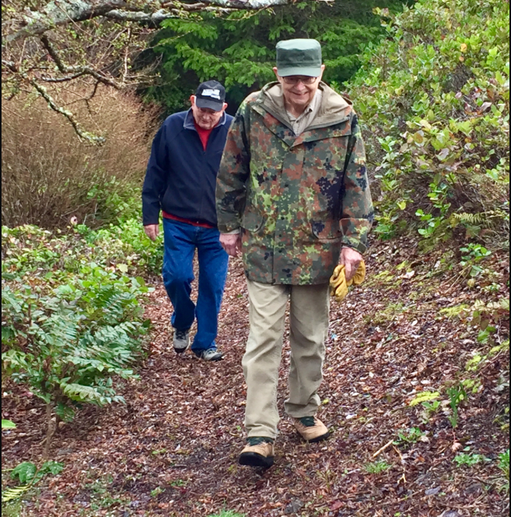
Many thanks to your neighbors at work

Slide 22
Many thanks to your neighbors at work

Slide 23
TVHA’s Future Focus
Maintain our sustainable status
Continue Active Pursuit of Vegetation Management Projects
Call for Volunteers
Help with VMC
Future Board service

Slide 24
Voting Options
A. Ratify the TVHA 2019-20 budget

Slide 25
Proposed Budget 2019-20
Timberton Village Homeowners Association
2019-20 Proposed Budget
Adopted by the Board of Directors on March 25, 2019
 |  | 2018-19 Current Modified Budget | 2019-20 PROPOSED BUDGET | CHANGE FROM PRIOR YEAR CURRENT MODIFIED BUDGET
Revenue
 | Dues | 27,456 | 27,456 | -
 | Less: Portion of Dues - Reserves for Asset Maint/Replacement ₍₂₎ | (2,316) | (2,880) | (564)
Total Operating Revenue |  | 25,140 | 24,576 | (564)
Operating Expenses:
 | Electrical | 480 | 480 | -
 | Insurance | 2,700 | 2,700 | -
 | Social | 300 | 300 | -
 | Taxes/Licenses/Fees/Permits | 75 | 75 | -
 | Misc | 160 | 160 | -
 | Ponds and Access Road Maintenance | 1,635 | 1,635 | -
 | Grounds Maintenance | 16,350 | 16,350 | -
 | VMC, Land and Capital Improvements ₍₁₎ ₍₂₎ | 5,280 | 2,026 | (3,254)
 | Office and Postage | 750 | 750 | -
 | Emergency Preparedness | 100 | 100 | -
 | Board Training ₍₁₎ | - | 1,500 | 1,500
 | Contingency ₍₁₎ | 16,859 | 15,359 | (1,500)
Total Operating Expenses |  | 44,689 | 41,435 | (3,254)
Fund Balance |  | (19,549) | (16,859) | 2,690

Slide 26
Notes for the Budget
Notes: 1. Contingency represents prior year-end uncommitted funds, less portion for Deferred Revenue. These funds are one-time in nature and represent that portion of the fund balance not budgeted to be spent. Use of these funds requires Board action per the TVHA Balance Budget Policy to move funds into appropriate budget line. No direct expense is paid out of the Contingency budget line item. - Balance as of July 1, 2018 was $19,549. - Unused funds of $690 from 2016-17, previously reallocated in 2017-18 were rebudgeted in the 2018-19 VMC budget line versus in Contingency. - On September 10, 2018, the Board approved the reallocation of $2,000 in Contingency representing unused 2017-18 VMC funding. - On March 25, 2019, the Board approved the Proposed Budget with the addition of $1,500 from Contingency to provide Board Training of the five new Board members in 2019-20. - Final fund balance adjustment will be made after the close of the fiscal year.
2. Utilized $774 of the 2018-19 Contribution to Reserve for Asset Maintenance and Replacement to fund the three new monument signs purchased in March.

Slide 27
Voting Options (cont.)
B. Ratify Board approval of the annual update of the Reserve Study

Slide 28
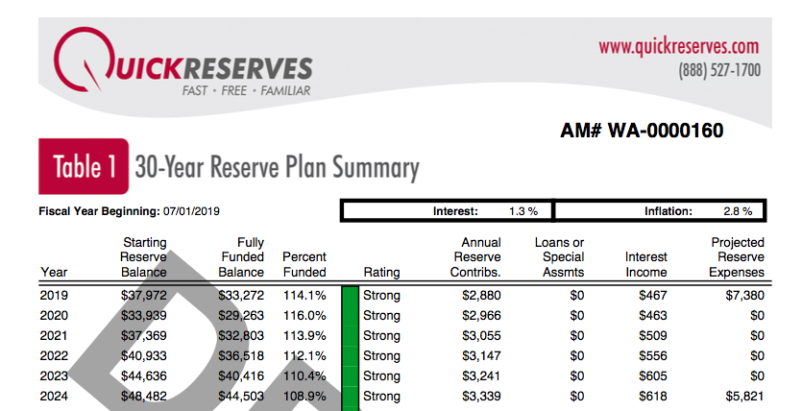
Annual update of the Reserve Study

Slide 29
Voting Options (cont.)
C. Election of five Board Directors
Five Director positions are open for vote this year. Candidates include:
Paul Hinton (two-year term)
Maria LeCato (two year term)
Ruth Schmitt (two-year term)
Roger Bryan (one-year unexpired term)
Tom Snelson (one-year unexpired term)
Other candidates?

Slide 30
Time to Vote!
Ballots have been distributed
Please vote now
Someone will collect completed ballots
Results will be announced as soon as the count is completed
Following the announcement of the voting results we will adjourn the formal meeting and begin the party!

Slide 31
Thank You, Neighbors!
Now, let’s get this party started

