Slide 2
Timberton Village Homeowners Association Annual Membership Meeting June 25, 2018

Slide 3
Topics
TVHA Status
Achievements this past year
Future Focus
Voting Options

Slide 4
TVHA Status 2018
Completed bidding process for Landscape contract- 2018 to 2020
The Website continues to be dynamic, current and informative thanks to Webmaster Rick Hellewell

Slide 5
History: End-of-Year Fund Balances

Slide 6
History: End-of-Year Fund Balances

Slide 7
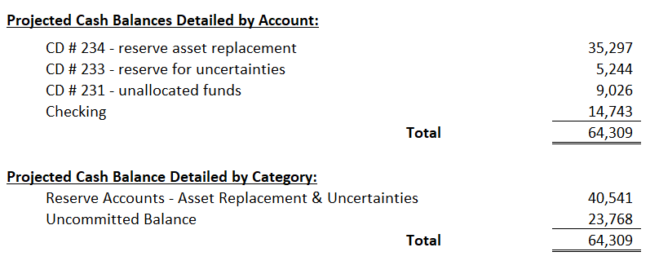
2017-18 Projected Year-end Cash Balance

Slide 8
Grounds Maintenance Contract
Clarified Statement of work
Extensive bidding process- 5 bidders
Contract awarded to Greenstate
Bid was affordable for our budget
2 years starting July 2018

Slide 9
Vegetation Management Projects
Finalized Gazebo Refurbishment
Memorial park hazardous tree removed
Trim and clean up of top of Timberton drive

Slide 10
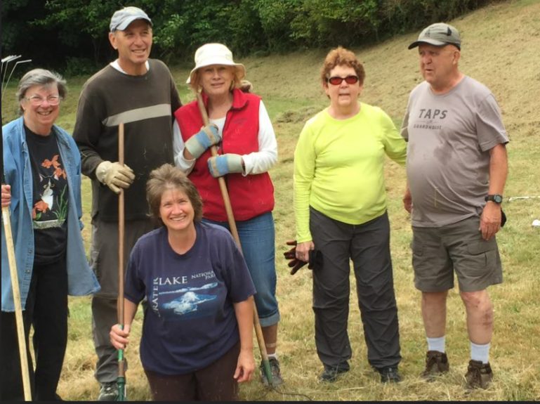
Double Pond clean up
Ruth Ann Hansen, Neil and Maureen Black,
Vicki Derrenberger, and Lloyd and Judy Gill

Slide 11
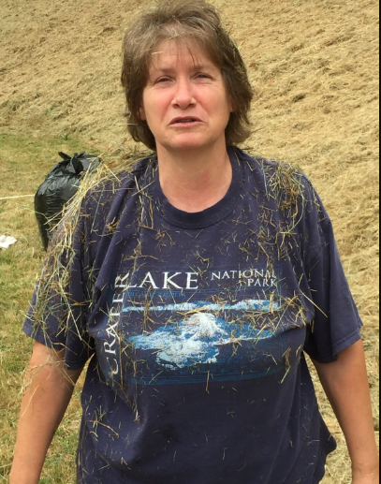
Total Emersion at Double Ponds
Vicki Derrenberger

Slide 12
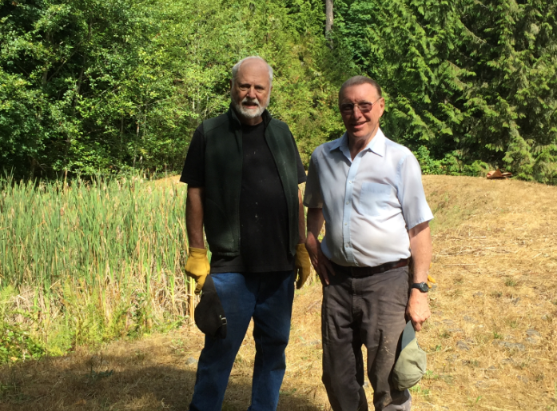
Cleaning up the Spinnaker Pond
Tom Woodnutt and Don Folsom

Slide 13
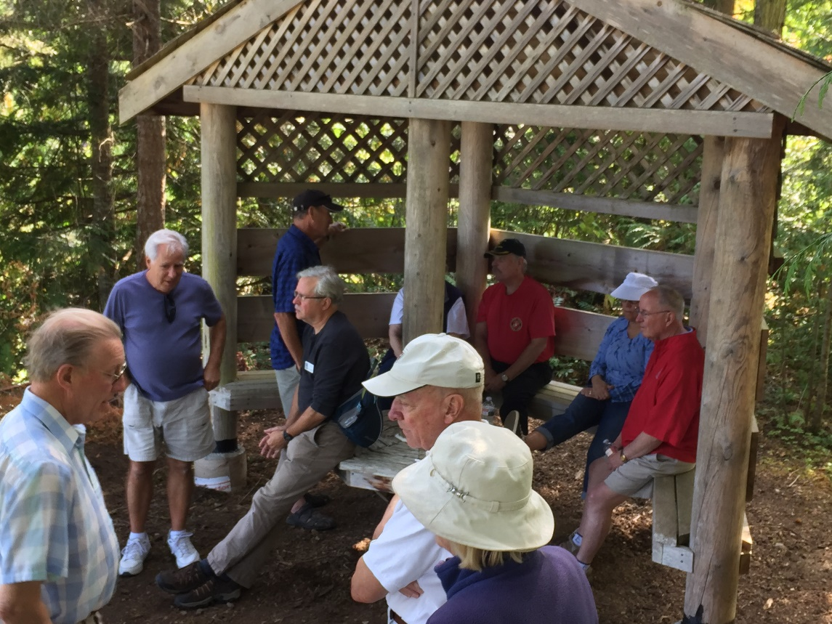
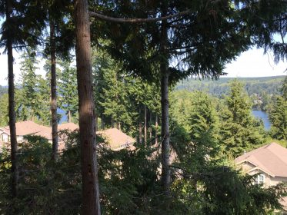
Gazebo Walk 8-19-17
View from Gazebo Looking West

Slide 14
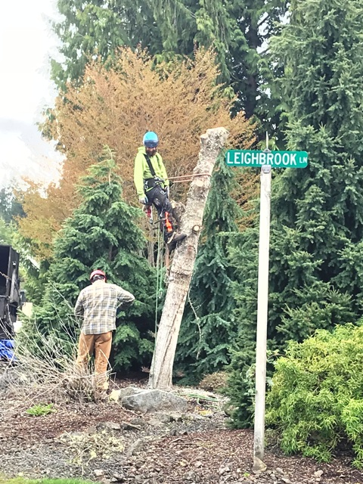
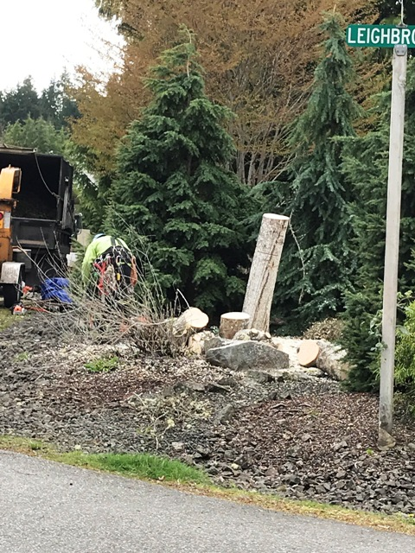
Memorial Park Tree Removal
March 2018

Slide 15
TVHA’s Future Focus
Maintain our sustainable status
Reduce Board meeting Frequency
Continue Active Pursuit of Vegetation Management Projects
Call for Volunteers
Help with VMC
Future Board service

Slide 16
Voting Options
A. Reallocation of reserve for uncertainties
Established by membership vote at 2014 Annual Meeting
Annual Fund of $1,310 set aside as a safety net
Current Balance $5,244.13
Redirect Ongoing Funds to Operating Budget in lieu of Dues Increase

Slide 17
Voting Options (cont.)
B. Ratify the TVHA 2018-19 budget

Slide 18
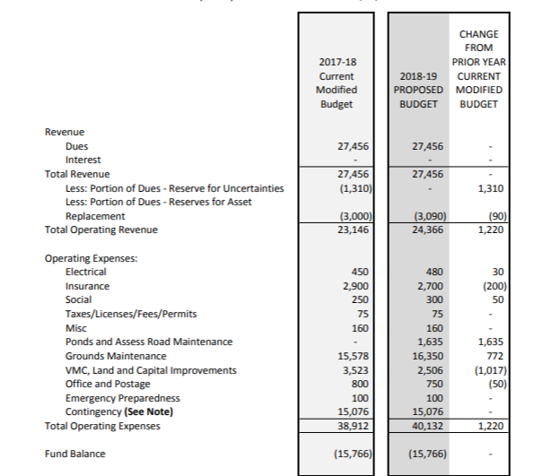
Proposed Budget 2017-18

Slide 19
Notes for the Budget

Slide 20
Voting Options (cont.)
C. Ratify Board approval of the annual update of the Reserve Study

Slide 21
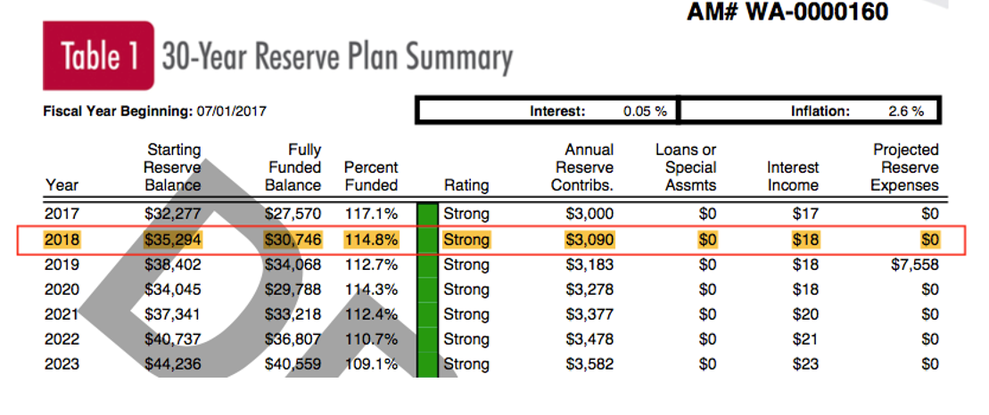
Annual update of the Reserve Study

Slide 22
Voting Options (cont.)
D. Election of three Board Directors
Incumbent Directors Debbie Wills and Vicki Derrenberger have another year to serve in their current terms
Three Director positions are open for vote this year. Candidates include:
Mike Burke (one year term)
Gloria Wilcox
Dave Tietjen
Other candidates?

Slide 23
Voting Options (cont.)
E. Reduction of Board Meeting Frequency from bi-monthly to Quarterly
Membership Approved Change to Bi-Monthly Board Meetings at 2014 Annual Meeting
Timberton Running Smoothly
Special Meetings May Be Held if Necessary
Other South Bay Villages Meet Quarterly

Slide 24
Time to Vote!
Ballots have been distributed
Please vote now
Someone will collect completed ballots
Results will be announced as soon as the count is completed
Following the announcement of the voting results we will adjourn the formal meeting and begin the party!

Slide 25
Thank You, Neighbors!

